Slide 1
Capstone Project Presentation
(CleverTap)
Sanchita Mangale
Sana Khan
Anshuman Jadhav
Ison Varghese

Slide 2
Agenda
Problem Statement
Data Set & Master Data Creation
EDA
ML Models
Future work

Slide 3
Problem Definition
Segment the audience of a content app based on its user’s propensity to watch a video in the next 2 days

Slide 4

And lots of dates !!
Data Set
AppLaunched ( 2716093, 8)
AppUninstalled (326684, 8)
VideoStarted (1796525, 12)
VideoDetails (3695451, 12)
UTMVisited (495850, 8)
Registered ( 329579, 9)

Slide 5

Master data Creations
We merge the data …. found the unique users… and did feature selections and came up with master data (466124, 130)
Some of the Important Features: (Selected)
Total videos watched
VOD(video on demand)
Q1, Q2, Q3 and Q4 - time quarters/day
UTM visited
Registration status.
Last video watched time…...and more..

Slide 6
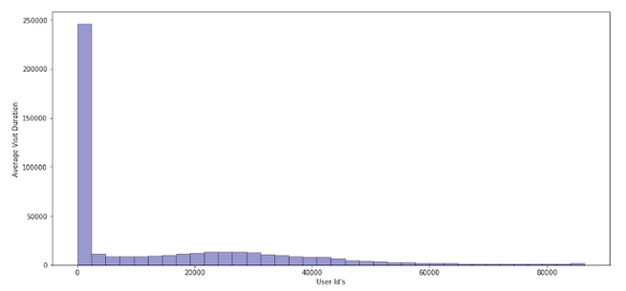
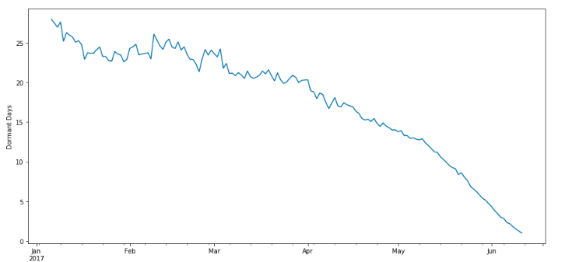
Exploratory Data Analysis :
Dormant Days Vs Months
Avg. Visit duration Vs User

Slide 7
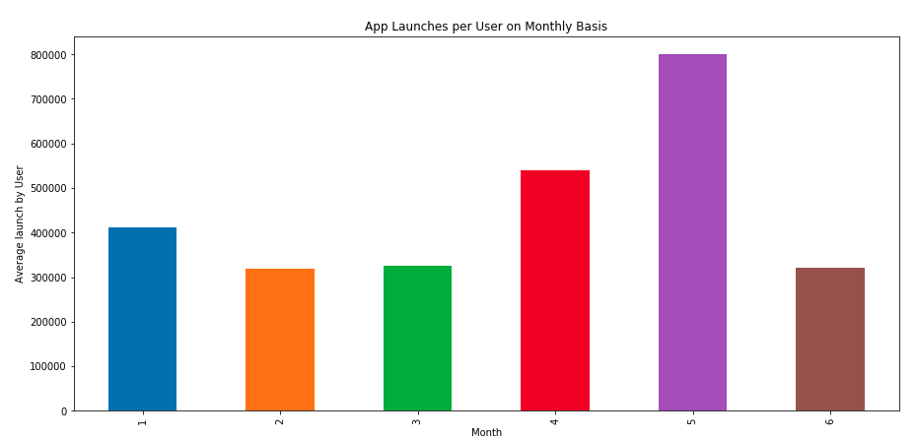
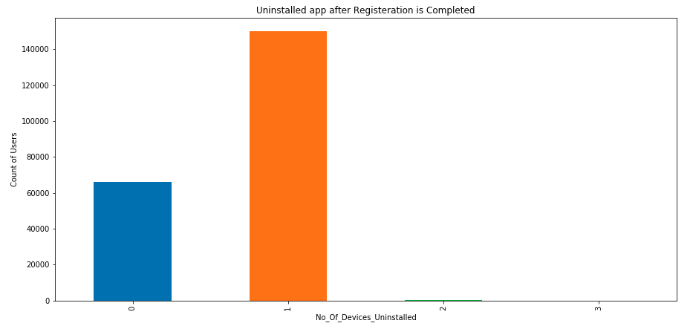
App Launches per user on monthly basis
Uninstalled app after registration completed

Slide 8
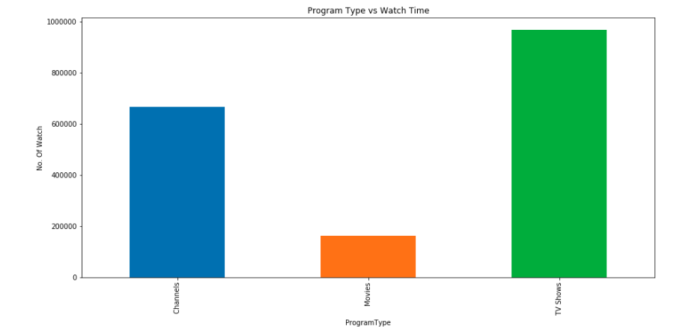
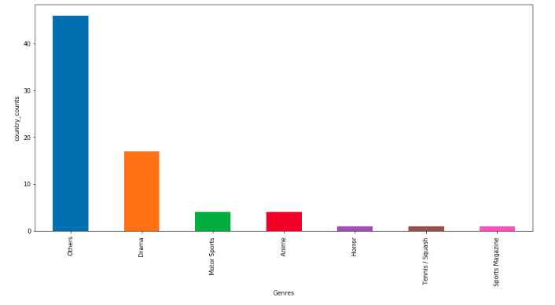
Programme type Vs Watch Time
Programme type Vs Watch Time
Country VS Genres

Slide 9
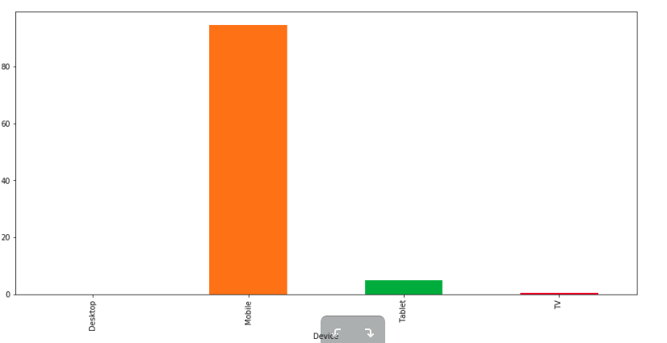
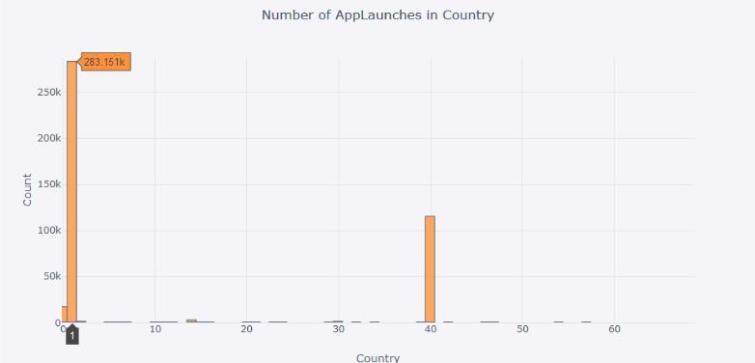
% of devices used
Nos of App launches per country

Slide 10
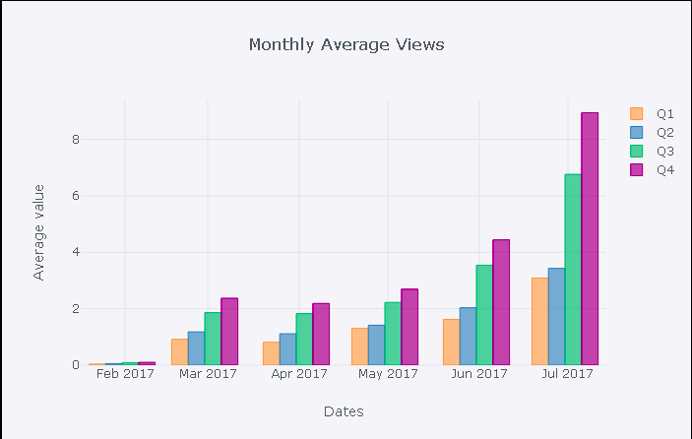
% of devices used

Slide 11
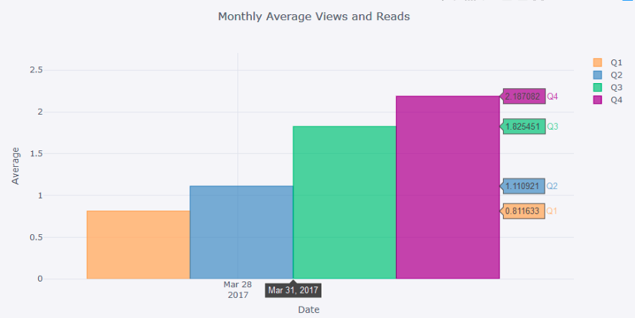
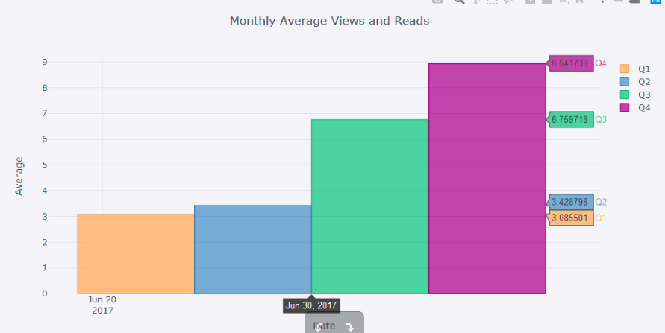
For the Month of March
For the Month of July

Slide 12
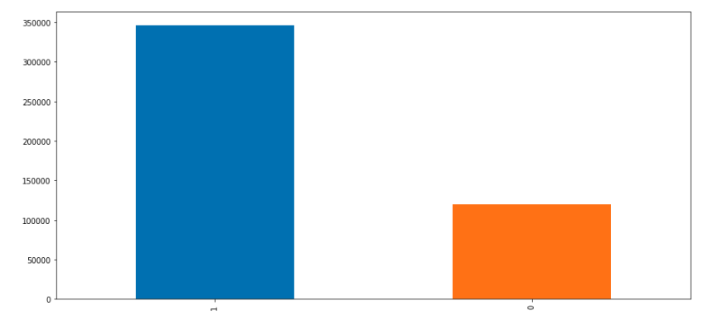
Dormant and Active Users

Slide 13
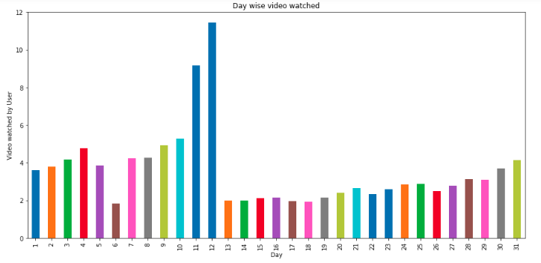
Day wised video watched

Slide 14
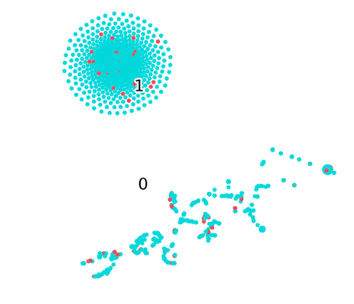

Dimension Reduction :
Principal Component Analysis
Explained Variance :
Tsne
Important Features :
VOD
Total Video Watched
Q3
Q4
Changed Explained Variance : 0.82 | 0.09
Dimensions are reduced to 2

Slide 15
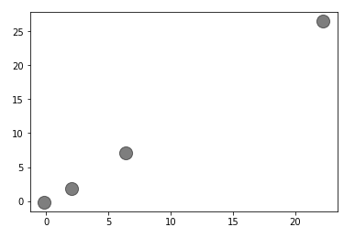
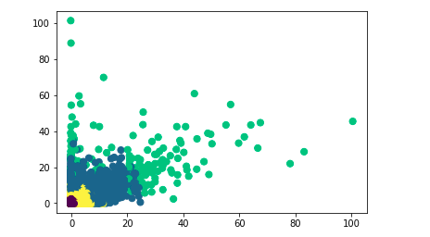
K means Centroids
Clustering
Algorithm :

Slide 16
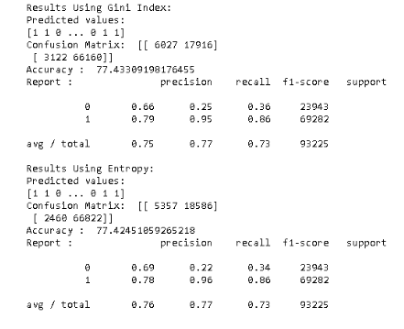
Decision Tree Results :

Slide 17
Things to be done further :
More nos of Hypothesis statement to be evaluated.
A/B testing ( If possible)
T-sne : In detail
Apply SVM

